Slide 1

Is data science a good career?
Presented by: manuel Cervantes, Ankita Gautam, Stephen Lane, Lorena Martinez, Joel Navarro

Slide 2
Presentation outline
Hypothesis
Data Cleanup
Data Analysis
Conclusion

Slide 3
Hypothesis
Hypothesis: The data career field is an emerging field with good salary and job prospects
Analysis will include data from Glassdoor and Department of Labor exploring the following areas:
Education and experience required
Salary
Industry areas
Job locations
Demand knowledge or experience with different program languages

Slide 4

Data & Clean up process
Kaggle
Glass door dataset
Time Period: 2018 – 2020 (Pre-Pandemic)
Department of Labor website
Multiple datasets
Time Period: 2020

Slide 5
Where Are the Jobs?
City | Job Count
Austin, TX | 345
Chicago, IL | 330
San Diego, CA | 304
New York, NY | 303
Houston, TX | 219
Philadelphia, PA | 210
Los Angeles, CA | 206
Dallas, TX | 180
San Antonio, TX | 177
Phoenix, AZ | 165

Slide 6
Let’s look at Texas
Texas | Job Count
Austin, TX | 345
Houston, TX | 219
Dallas, TX | 180
San Antonio, TX | 177

Slide 7
Typical education and experience (dol data)
Not a large demand to have prior experience in the industry
90% of all occupations required some sort of formal education, 60% of which required a Bachelor’s degree

Slide 8
How much Do they pay?

Slide 9
Glassdoor Salary statistics
75% of the estimated salaries comes from senior level positions
50% of the estimated salaries mostly consist of positions that are mid-level positions.
25% of the estimated salaries is entry level positions
The minimum salary is entry level positions that do not require much data analytical skills (i.e., python, VBA, SQL, etc.)

Slide 10
TOP 10 job titles on glass door
Job Title | #
Data Scientist | 274
Data Engineer | 260
Sr Data Scientist | 91
Machine Learning Engineer | 47
Sr Data Analyst | 47
Big Data Engineer | 41
Business Intelligence Analyst | 39
Sr Data Engineer | 37
Lead Data Scientist | 23

Slide 11
Who needs data scientists?
Industry Sectors | Count
IT Services | 472
Staffing & Outsourcing | 313
Biotech & Pharmaceuticals | 293
Computer Hardware & Software | 264
Internet | 238
Health Care Services & Hospitals | 197
Consulting | 166
Enterprise Software & Network Solutions | 150
Investment Banking & Asset Management | 109
Advertising & Marketing | 93
Insurance Carriers | 91
Colleges & Universities | 84
Top Industries Hiring Data Scientists

Slide 12
Choose Your Preferred Method of Learning
Degree
Boot Camps
Certified Programs

Slide 13
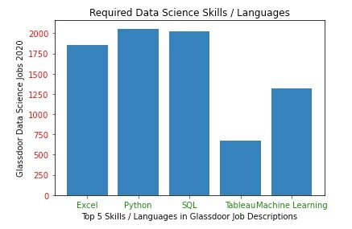
How do you become a Data Scientist?
Required Skills
Python
R
SQL
Scala
Julia
JavaScript
C/C++
Mat Lab
Excel
Machine Language
HTML
Swift
SAS

Slide 14
Conclusions
The data career field has a high average and maximum salary potential
The are no shortage of opportunities people who enter the career field
Texas seemed to have abundant jobs in major cities, with Austin, TX being the highest
To reach the higher end of the pay scale applicants may need to seek at least a bachelor’s degree
Excel, Python and SQL knowledge are the most demanded skill sets

